Slide 1
Preliminary Findings

Slide 2
Appraisal Overview 评估概述
Notes:
Information in this section should come from the appraisal plan. The idea here is not to duplicate the contents of the plan, but to provide a summary for the Appraisal Sponsor, and the personnel from the OU who will see these findings.
The ATL may add additional information to the final findings presentation, but this minimum content must be present.

Slide 3






























It has been a pleasure working with you.
We look forward to present the preliminary findings for your validation.
很荣幸这段时间与您共事，现在向您展示初步结果，供您确认
Notes:
Introduction. Also an opportunity to talk a bit about Demix
Demix has LAs from across the globe and performs appraisals around the world
Demix is one of the largest CMMI services providers globally
Demix also provide other citification services, such as ISO, COBIT, MAX
It is a pleasure and honour to be here with you today. We are looking forward to work with you and your team over the coming days.
早晨好。今天我很高興和榮幸來到這裡，我期待著在未來的几天里與您和您的團隊一起工作。

Slide 4
Appraisal Principles
Start with a process framework
以一个过程框架作为开始
Observe strict confidentiality and non-attribution
严格遵循保密性和不归因性
Involve senior management as appraisal sponsor
把高层作为评估发起人
Approach appraisal collaboratively to the extent possible
评估需要协调合作进行
Focus on action
关注行动
Notes:
1, what ever you share is confidential with the ATM’s and
2, non – your name will not appear in any reports
collaboratively – we have representation from your side as well as ours last at the end there are always weaknesses and from there an improvement action is always undertaken

Slide 5
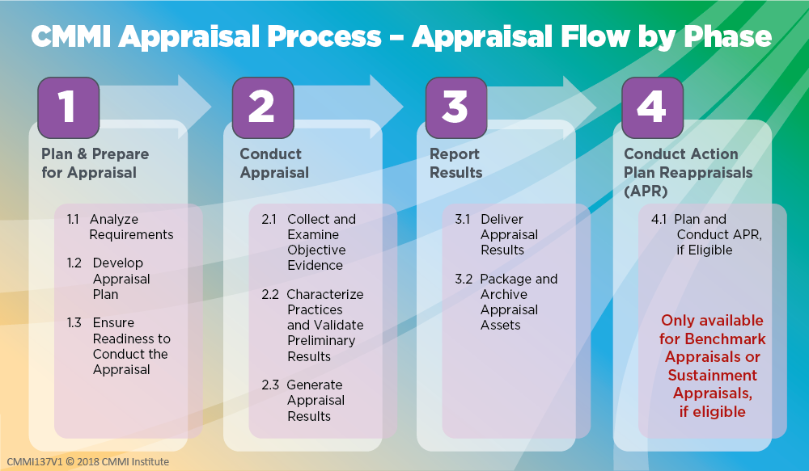

Slide 6
About Preliminary Findings
These are the preliminary findings. They are not the final findings. We encourage you to provide feedback on what is presented. 我们现在所进行的是初步发现，还没有到最终发布阶段，欢迎你们对发现结果提供反馈
It is recommended that the presenter reads the findings verbatim. 建议演讲者逐字逐句子表达调查发现的内容
The appraisal team CANNOT commit to making changes, we will collect your input and evaluate it after the presentation. 评估小组成员不能向你们承诺对发现进行修改，我们会把你们的反馈记录下来
Confidentiality and non-attribution remain in effect. 保密原则和非归因原则依然有效
Strengths are only noted if they are significant strengths. 只有发现特别明显的强项时才会反映出来

Slide 7
Virtual appraisals – code of conduct
A virtual appraisal code of conduct must include the following rules at a minimum: (ISACA MDD v2.2)
远程评估行为准则必须包括以下规则：(ISACA MDD v2.2)
Participate actively in appraisal activities 积极参与评估活动。
No sleeping, multitasking, etc. 不允许睡觉，或进行其他工作等。
To meet confidentiality requirements, ATL may require no additional media or writing materials, laptops, or mobile devices other than those agreed as necessary for conducting virtual activities for some or all interviews 为了满足保密需求，除了评估所需的设备和材料外，主任评估师可能不需要其他设备或材料：包括纸质材料，其他笔记本电脑，移动设备等。
One person speaks at a time 每次只允许一个人说话。
All participants identify themselves when needed, including when asked by ATL, to verify their identity with a government issued photo ID. 评估师要求时，所有访谈人员需要出示身份证验证身份，身份证由政府发放且附带个人照片。
Additional required actions 其他行为准则：
Video cameras should be on at all time. 摄像机需要一直保持开启状态。

Slide 8
Findings Definitions – Required Categories
Required Findings Categories:
Weaknesses - A type of preliminary or final finding, which is an ineffective, or lack of implementation of one or more processes that meet the intent and value of a practice based on verified objective evidence, and applicable across the project(s) and organizational support functions or Organizational Unit as a whole. This is realized either by a) the process itself does not address a CMMI practice requirement, or b) the project(s) or organizational support functions are not following their process that IS compliant with the intent and value of the applicable CMMI practice.
Strengths - A type of preliminary or final finding, which is an exemplary or noteworthy implementation of a process that meets the intent and value of a CMMI model practice.
所需结果类别：
弱项——一种初步或最终的发现，是指一个或多个过程实施无效或缺乏实施，这些过程基于已验证的客观证据，符合实践的意图和价值，适用于整个项目和组织支持职能组或组织单元。这可以通过以下两种方式实现：a）过程本身没有满足CMMI实践需求，或者b）项目或组织支持职能组没有遵循符合适用CMMI实践意图和价值的过程。
强项——一种初步或最终的发现，是一个模范性或值得注意的过程实现，其符合CMMI模型实践的意图和价值。

Slide 9
Practice Area Findings 实践域发现

Slide 10

Causal Analysis and Resolution (CAR) 原因分析与解决
Intent: Identifies causes of selected outcomes and takes action to either prevent recurrence of undesirable outcomes or ensure recurrence of positive outcomes. 确定所选结果的原因，并采取行动防止不良结果的再次发生或确保积极结果的再次出现。
Value: Addresses causes of issues, eliminating rework and directly improving quality and productivity. 解决问题的根源，消除返工，直接提高质量和生产力。
Strengths 强项:
None 没有
Weaknesses 弱项:
None 没有

Slide 11

Configuration Management (CM) 配置管理
Intent: Manages the integrity of work products using configuration identification, version control, change control, and audits. 通过配置识别、版本控制、变更控制和审计来管理工作产品的完整性。
Value: Reduces loss of work and increases the ability to deliver the correct version of the solution to the customer. 减少工作丢失并提高向客户交付正确版本解决方案的能力。
Strengths 强项:
None 没有
Weaknesses 弱项:
None 没有

Slide 12

Decision Analysis and Resolution (DAR) 决策分析与解决
Intent: Makes and records decisions using a recorded process that analyzes alternatives. 使用记录的流程来分析备选方案，并做出和记录决策。
Value: Increases the objectivity of decision-making and the probability of selecting the optimal solution. 提高决策的客观性和选择最佳解决方案的可能性。
Strengths 强项:
None 没有
Weaknesses 弱项:
None 没有

Slide 13

Estimating (EST) 估算
Intent: Estimates the size, effort, duration, and cost of the work and resources needed to develop, acquire, or deliver the solution. 估算开发、获取或交付解决方案所需的工作和资源的规模、努力、持续时间和成本。
Value: Provides a basis for making commitments, planning, and reducing uncertainty, which allows for early corrective actions and increases the likelihood of meeting objectives. 为做出承诺、规划和减少不确定性提供基础，从而允许及早采取纠正措施，并提高实现目标的可能性。
Strengths 强项:
None 没有
Weaknesses 弱项:
None 没有

Slide 14

Governance (GOV) 管治
Intent: Provides guidance to senior management on their role in the sponsorship and governance of performance, processes, and related activities. 为高级管理层提供关于其在绩效、流程及相关活动的赞助和治理中的角色的指导。
Value: Minimizes the cost of process implementation, increases the likelihood of meeting objectives, and verifies that the implemented processes support and contribute to the success of the business. 减少流程实施成本，提高实现目标的可能性，并验证已实施的流程支持并促进业务成功。
Strengths 强项:
None 没有
Weaknesses 弱项:
None 没有

Slide 15

Implementation Infrastructure (II) 实施基础条件
Intent: Ensures that the processes and assets important to an organization’s performance are habitually and persistently followed, used, and improved. 确保对组织绩效重要的流程和资产得到习惯性和持久的遵循、使用和改进。
Value: Sustains the ability to consistently achieve goals and objectives efficiently and effectively. 维持高效且有效地持续实现目标和任务的能力。
Strengths 强项:
None 没有
Weaknesses 弱项:
None 没有

Slide 16

Managing Performance and Measurement (MPM) 管理绩效与度量
Intent: Manages performance using measurement and analysis to achieve business objectives. 使用测量和分析来管理绩效，以实现业务目标。
Value: Maximizes business return on investment by focusing management and improvement efforts on cost, schedule, and quality performance. 通过将管理和改进工作集中在成本、进度和质量绩效上，最大化业务投资回报。
Strengths 强项:
None 没有
Weaknesses 弱项:
None 没有

Slide 17

Monitor and Control (MC) 控制与监督
Intent: Provides an understanding of the project progress so appropriate corrective actions can be taken when performance deviates significantly from plans. 提供对项目进展的理解，以便在绩效与计划明显偏离时采取适当的纠正措施。
Value: Increases the probability of meeting objectives by taking early actions to adjust for significant performance deviations. 通过及早采取行动调整重大绩效偏差，增加实现目标的可能性。
Strengths 强项:
None 没有
Weaknesses 弱项:
None 没有

Slide 18

Organizational Training (OT) 组织级培训
Intent: Develops the skills and knowledge of personnel so they perform their roles efficiently and effectively. 培养人员的技能和知识，使他们能够高效、有效地完成自己的角色。
Value: Enhances individuals' skills and knowledge to improve organizational work performance. 提升个人的技能和知识，以改善组织的工作绩效。
Strengths 强项:
None 没有
Weaknesses 弱项:
None 没有

Slide 19

Peer Reviews (PR) 同行评审
Intent: Identifies and addresses process performance and work product issues through reviews by the producer's peers or Subject Matter Experts (SMEs). 通过由生产者的同行或专家进行的审查，识别和解决过程绩效和工作产品问题。
Value: Reduces cost and rework by uncovering issues or defects early. 通过及早发现问题或缺陷，降低成本和返工。
Strengths 强项:
None 没有
Weaknesses 弱项:
None 没有

Slide 20

Planning (PLAN) 策划
Intent: Develop plans to describe what is needed to accomplish the work within the standards and constraints of the organization. 制定计划，描述在组织的标准和限制条件下完成工作所需的内容。
Value: Optimizes cost, functionality, and quality to increase the likelihood of meeting objectives. 优化成本、功能和质量，增加实现目标的可能性。
Strengths 强项:
None 没有
Weaknesses 弱项:
None 没有

Slide 21

Process Asset Development (PAD) 过程资产开发
Intent: Develops the process assets necessary to perform the work and keeps them updated. 开发完成工作所需的流程资产，并保持其更新。
Value: Provides a capability to understand and repeat successful performance. 提供理解和重复成功绩效的能力。
Strengths 强项:
None 没有
Weaknesses 弱项:
None 没有

Slide 22

Process Management (PCM) 过程管理
Intent: Manages and implements the continuous performance improvement of processes and infrastructure to meet business objectives by identifying and implementing the most beneficial process improvements and making performance results visible, accessible, and sustainable. 通过识别和实施最有益的流程改进，并使绩效结果可见、可访问和可持续，管理和实施流程和基础设施 的持续绩效改进，以实现业 务目标
Value: Ensures that processes, infrastructure, and their improvement contribute to successfully meeting business objectives. 确保流程、基础设施及其改进对成功实现业务目标起到贡献。
Strengths 强项:
None 没有
Weaknesses 弱项:
None 没有

Slide 23

Process Quality Assurance (PQA) 过程质量保证
Intent: Verifies and enables improvement of the quality of the processes performed and resulting work products. 验证并促进所执行的流程和最终工作产品的质量改进。
Value: Increases the consistent use and improvement of the processes to maximize business benefit and customer satisfaction. 增加对流程的一贯使用和改进，以最大化业务效益和客户满意度。
Strengths 强项:
None 没有
Weaknesses 弱项:
None 没有

Slide 24

Product Integration (PI) 产品集成
Intent: Integrates and delivers the solution that addresses functionality, performance, and quality requirements. 整合并交付解决方案，满足功能、性能和质量要求。
Value: Increases customers' satisfaction by giving them a solution that meets or exceeds their functionality and quality requirements. 通过为客户提供满足或超出其功能和质量要求的解决方案，提高客户满意度。
Strengths 强项:
None 没有
Weaknesses 弱项:
None 没有

Slide 25

Requirements Development and Management (RDM) 需求开发与管理
Intent: Elicits requirements, confirms common understanding by stakeholders, and aligns requirements, plans, and work products. 引发需求，通过利益相关者确认共同理解，并将需求、计划和工作产品对齐。
Value: Increases likelihood that the solution meets or exceeds customer expectations and needs. 增加解决方案满足或超出客户期望和需求的可能性。
Strengths 强项:
None 没有
Weaknesses 弱项:
None 没有

Slide 26

Risk and Opportunity Management (RSK) 风险与机会管理
Intent: Identifies, records, analyzes, and manages potential risks or opportunities. 识别、记录、分析和管理潜在的风险或机遇。
Value: Mitigates adverse impacts or capitalizes on positive impacts to increase the likelihood of meeting objectives. 减轻不利影响或利用积极影响，增加实现目标的可能性。
Strengths 强项:
None 没有
Weaknesses 弱项:
None 没有

Slide 27

Technical Solution (TS) 技术解决方案
Intent: Designs and builds solutions that meet requirements. 设计并构建满足要求的解决方案。
Value: Provides a cost-effective design and solution that meets customer requirements and reduces rework. 提供符合客户要求并减少返工的成本效益设计和解决方案。
Strengths 强项:
None 没有
Weaknesses 弱项:
None 没有

Slide 28

Verification and Validation (VV) 验证与确认
Intent: Confirms selected solutions and components meet their requirements, and demonstrates selected solutions and components fulfill their intended use in their target environment. 确认所选解决方案和组件符合其要求，并展示所选解决方案和组件在其目标环境中履行其预期用途。
Value: Increases the likelihood that the solution will satisfy the customer. 增加解决方案能够满足客户的可能性。
Strengths 强项:
None 没有
Weaknesses 弱项:
None 没有

Slide 29


Slide 30
Notice
This pptx has embedded links to 00_Data_Reference.xlsm
The latest information and version of the Benchmark Appraiser Support Environment (BASE) can be accessed at www.demix.org/tools

